Slide 1
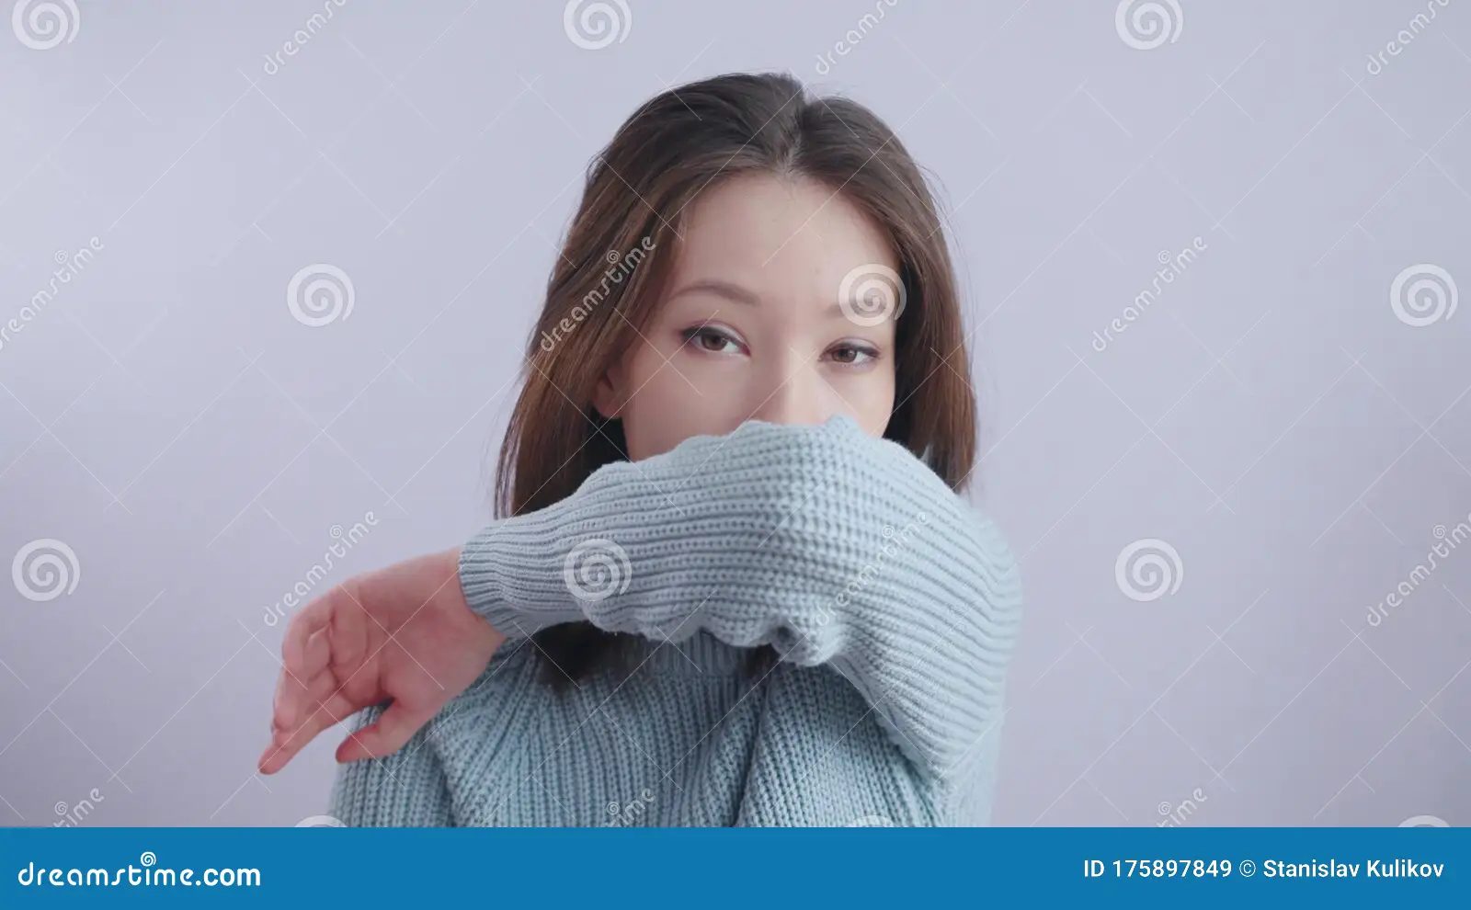
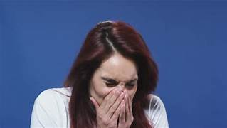
TASK 06:- STORY BOARDING
CORONAVIRUS-
- SAFTEY RULES

Slide 2
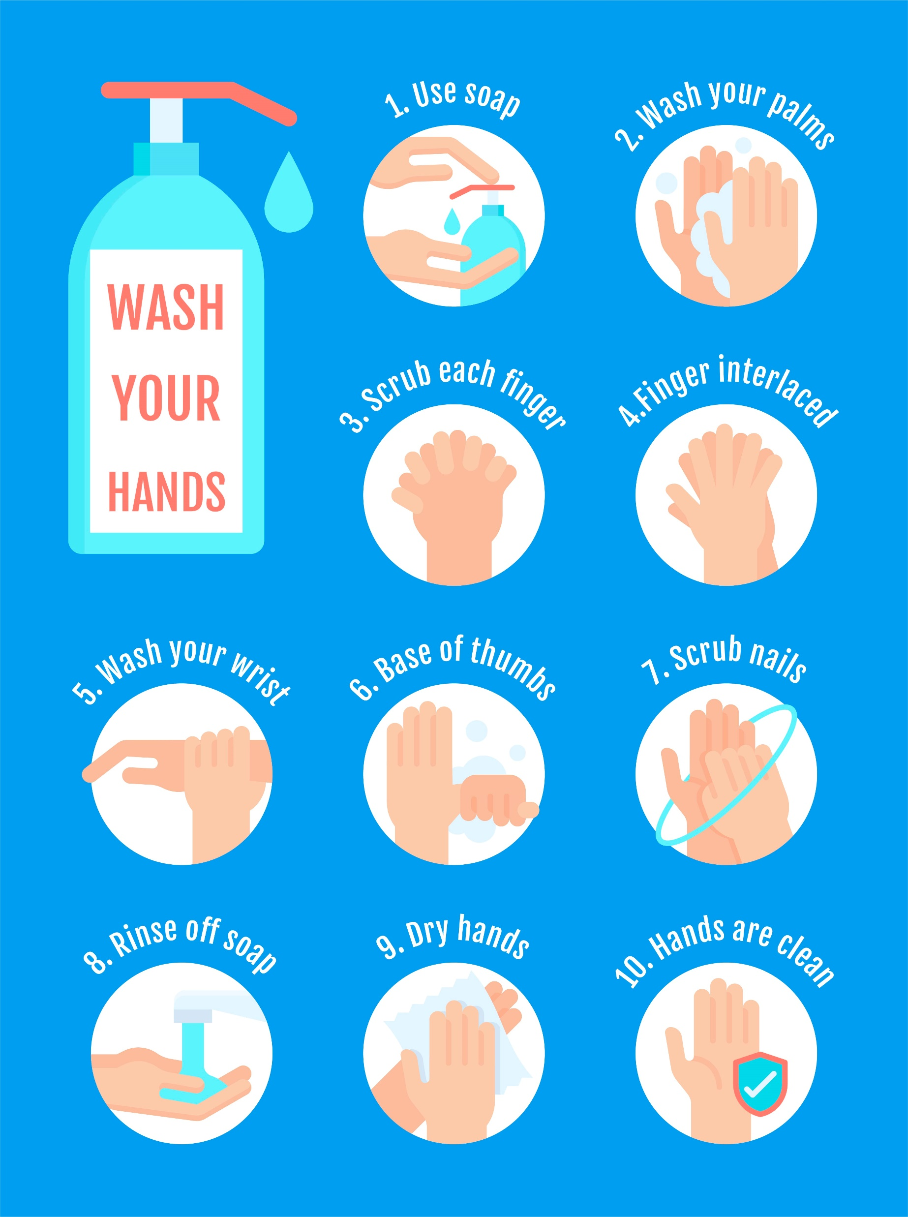
The main thing in this pandemic situation is:-

Slide 3

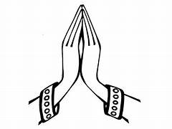
Major things to be followed are:-

Slide 4
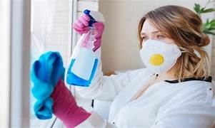
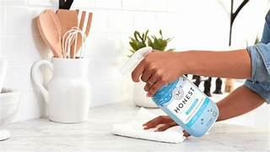
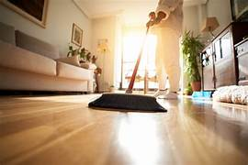
things
These

Slide 5
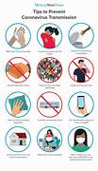
FOLLOWING OF THIS:-
WE CAN SAVE OUR LIFE
WE CAN SECURE OURSELVES
BEING HAPPY LIFE
REDUCING OF THE VIRUS
BEING HEALTHY

